Slide 1
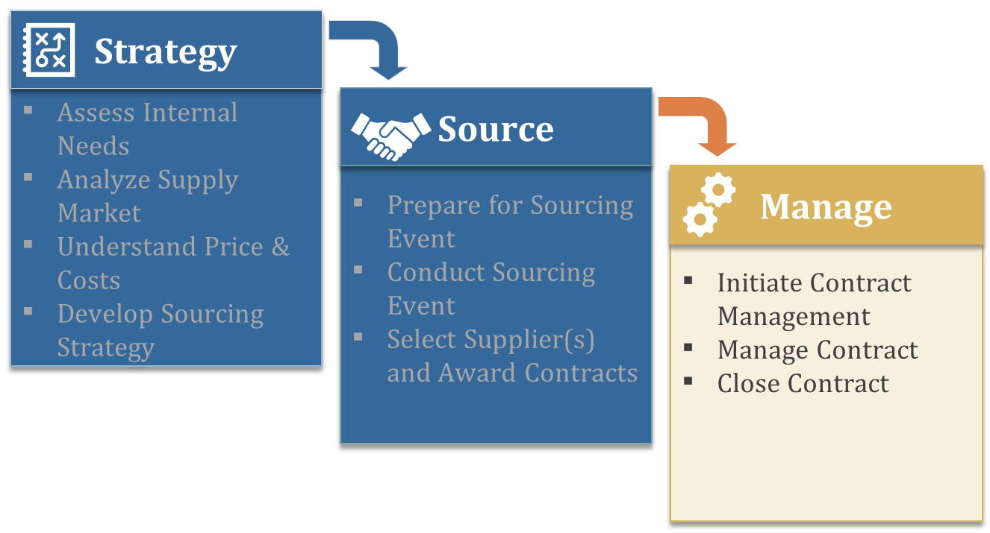
Contract Management
Deliver as Promised
Notes:
Introductions; The goal of this course is to engage in a conversation related to ensuring that value is not just received but also enhanced during the Manage phase of strategic sourcing. The way this is achieved is by way implementing a robust contract management plan.

Slide 2
CONTENTS
Introduction to Contract Management
Initiate Contract Management
1. Identify Stakeholders & Define Roles and Responsibilities
2. Conduct Internal and External Kick-off Meetings
3. Develop Performance Measurement System
(Measuring Performance, KPIs, Supplier Performance Score Card)
4. Agree on Contract Management Plan (CMP)
5. Agree on Relationship Management Process
Summary and Checklist
Manage Contract
Measure Supplier’s Performance
(KPIs, Spend, Financial Health)
Conduct Performance Reviews
Manage Contract Pricing
Conduct Value Improvement Program
Manage and Control Changes, Claims and Disputes
Summary and Checklist
Close Contract
Conclude Supply Agreement
Capture Lessons Learned
Summary and Checklist

Slide 3
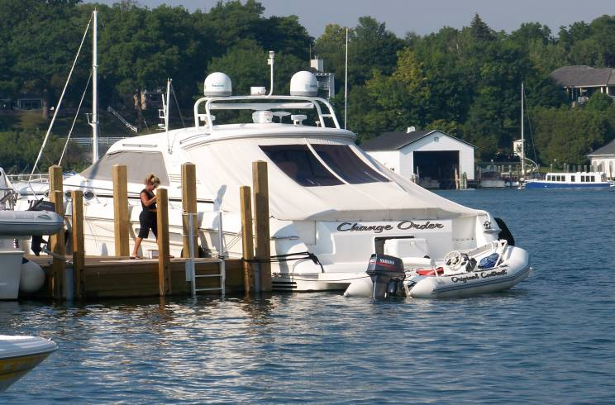
COMPANIES LOSE FROM POOR CONTRACT MANAGEMENT
Change Order
Original Contract
Notes:
Emphasize the fact that a contract should run like a well-oiled machine. We want no hiccups – supply must we assured at all times in the most competitive manner. With a great contract management process we should always be ahead of the curve. Ask participants to help list out their thoughts of what good contract management is and what are common problems that are observed. 5-7min exercise.

Slide 4
TOP QUARTILE CONTRACT MANAGEMENT MEANS…
The contract is understood and available at all times
Company and supplier’s objectives are aligned and KPI’s are in place
A “Contract Management Plan” addresses key risks and monitors performance
Specifications are continually reviewed for appropriateness
Demand is forecasted and managed by the company
Cost improvements are delivered and result in budget adjustments
Supplier relationship is maintained to avoid breakdowns in communication and goals
Learning from others’ experiences (audits, reviews, feedback)
Escalate issues to ensure management focus and resolution
Notes:
Share how Nokia’s specifications asked for 10K cycles of performance from the cell phone charger. What is appropriate? Share Freeport’s need to understand the costs of heavy equipment – supplier asked them to lock demand so they could procure raw materials. To enable a competitive advantage it is critical to ensure that the supplier understands the need so that they can think of ways to create an advantage. Just like a relationship – good communications are essential.

Slide 5
PHASES OF CONTRACT MANAGEMENT
Initiate Contract Management
Manage Contract
Close Contract
  Key outcomes:
  Roles & Responsibilities
  Relationship Strategy
  Contract Management Plan
  Performance Reviews
  Supplier Relationship
  Continuous Improvement
  Close-out activities
  Feedback

Slide 6
CONTRACT SEGMENTATION DETERMINES LEVEL OF CONTRACT MANAGEMENT
All contracts (100%)
High Impact & Risk
High/Low and Low/High cases
Low Impact & Risk
(Kraljic matrix)
Segmentation
“Tier 1”
“Tier 2”
“Tier 3”
(Contract types)
60%
30%
10%
A Tier 1 contract requires a higher level of contract management effort, whereas a Tier 3 contract requires much less effort (Tier 2: in between), which influences:
Resource requirements
Areas of focus (HSSE, Delivery, Value Improvement)
Notes:
To help us on this journey it is important to understand/prioritize contracts. It is typical that many of the contracts are Tier 3 (e.g. 60% of all contracts). Our desire is to focus our limited resources on the most important ones (Tier 1) and then go down the chain. Contract segmentation helps to determine contract management requirements.

Slide 7
KRALJIC MATRIX
Leverage
Strategic
High expenditures, commodity items
Many alternate products and services
Many qualified sources of supply
Market/Price Sensitive
Critical to profitability and operations
Few qualified sources of supply
Large expenditures
Design and Quality are critical
HIGH
Business (Profit) Impact
Non-critical
Bottleneck
Many alternative products and services
Many sources of supply
Low value; small individual transactions
Complex specs
Few alternate productions/sources of supply
New technology or untested processes
LOW
LOW
HIGH
Supply Risk *
* Potential risk factors such as: Supply availability / number of suppliers • Shortages in capacity; market structure • Technical requirements (standard vs. specific) • Complexity of specification • Process complexity • Pace of technology change • Quality, environmental and safety risks • Economic volatility • Initial investments (e.g. development costs, tooling) • Development lead time • Transition time (to move to alternative source) • Supply chain length, dangers • Importance of the product for the total system

Slide 8
CONTRACT SEGMENTATION BASED ON KRALJIC MATRIX
Tier 2 contract
Tier 1 contract
HIGH
Business (Profit) Impact
Tier 3 contract
Tier 2 contract
LOW
LOW
HIGH
Supply Risk *
* Potential risk factors such as: Supply availability / number of suppliers • Shortages in capacity; market structure • Technical requirements (standard vs. specific) • Complexity of specification • Process complexity • Pace of technology change • Quality, environmental and safety risks • Economic volatility • Initial investments (e.g. development costs, tooling) • Development lead time • Transition time (to move to alternative source) • Supply chain length, dangers • Importance of the product for the total system

Slide 9
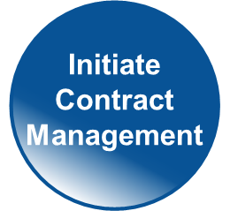
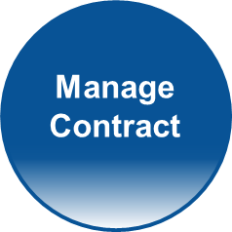
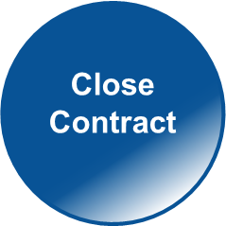
CONTRACT MANAGEMENT STEPS BY CONTRACT TYPE
Tier:
Steps:
1
2
3
Identify Stakeholders, Define Roles and Responsibilities
Conduct Internal and External Kick-off Meetings
Develop Performance Measurement System
Agree on Contract and Relationship Management Process and Plan
1
2
3
1
2
3
1
2
3
1
2
3
Measure Supplier's Financial Health & Performance (KPIs)
Conduct Performance Reviews (Tier 1: 1x quarter, Tier 2: 1x year)
Manage Contract Pricing (CAMSTM/Price DisciplineTM)
Conduct Value Improvement Programs (A&D Cost Challenge)
Manage & Control Contract Changes, Claims & Disputes
1
2
3
1
2
3
1
2
3
1
2
3
1
2
3
Conclude supply agreement
Capture lessons learned
- Mandatory step
- Optional
- Not Required
1
2
3
Rationale to be provided when not performed
1 = Tier 1 contract, etc.

Slide 10
INITIATE CONTRACT MANAGEMENT
Introduction to Contract Management
Initiate Contract Management
Identify Stakeholders & Define Roles and Responsibilities
Conduct Internal and External Kick-off Meetings
Develop Performance Measurement System
(Measuring Performance, KPIs, Supplier Performance Score Card)
Agree on Contract Management Process and Plan (CMP)
Agree on Relationship Management Process
Summary and Checklist
Manage Contract
Measure Supplier’s Performance
(KPIs, Spend, Financial Health)
Conduct Performance Reviews
Manage Contract Pricing
Conduct Value Improvement Program
Manage and Control Changes, Claims and Disputes
Summary and Checklist
Close Contract
Conclude Supply Agreement
Capture Lessons Learned
Summary and Checklist

Slide 11
INITIATE CONTRACT MANAGEMENT
Objective:
To align stakeholders, suppliers and the contract management team around the objectives of the contract
Steps:
1
2
3
Identify Stakeholders, Define Roles and Responsibilities
Conduct Internal and External Kick-off Meetings
Develop Performance Measurement System
Agree on Contract and Relationship Management Process and Plan
1
2
3
1
2
3
1
2
3
  Key outcomes:
  Roles & Responsibilities
  Relationship Strategy
  Contract Management Plan
Notes:
Every journey begins with a single step and the first step is to initiate the contract management process.
A quick note – you will see a legend at the top of some of the slides. This legend suggests from our perspective for which contract type the topic of discussion is applicable.

Slide 12
1. IDENTIFY STAKEHOLDERS, DEFINE ROLES AND RESPONSIBILTIIES
1
2
3
Points to consider
  Roles and responsibilities of team members may vary depending on the value and risk of the contract:
    Tier 3 contracts: One person may assume multiple roles
    Tier 1 & 2 contracts : Additional roles and responsibilities such as Contract Owner or Contract Engineer may be added
Internal stakeholders include titles such as:
Executive Sponsor Contract Owner Contract Holder Contracting & Procurement Representative, Contract Engineer | Business Managers, Site Representative HSSE Representative Finance Manager or Representative Supplier Manager
*
Notes:
Remember NASCAR race: The one important thing that we identified was each person knew their role and responsibility. Can we talk about the responsibilities of each role? And how do they connect with the contract segment (Tier 1,2,3)?

Slide 13
ROLES AND RESPONSIBILITIES
Contract Owner
Planning Appoint Contract Holder Inform internal stakeholders & supplier about appointment
Managing Contracts Manage portfolio of contracts Review and control contract execution Approve delivery of contract requirements Monitor performance of the Contract Holder
Analyze/Improve Monitor improvement plans with Contract Holder Endorse contract Key Performance Indictors (KPIs) Participate in assurance visits and audits
Notes:
Discuss how to measure performance of Contract holder, how to perform CH role better/ support CH better. How often does a contract owner meet with each contract team?

Slide 14
ROLES AND RESPONSIBILITIES
Contract Holder
Planning Review contract risk Oversee pre-mobilization and mobilization activities related to the contract
Managing Contracts Implement and monitor contract management and HSSE plans Review and control contract execution Manage incident reporting Make contract interface arrangements
Analyze/Improve Set contract KPIs Record and analyze HSSE and contract performance Conduct value improvement plans Participate in assurance visits and audits
Notes:
Discuss how to measure performance of Contract Holder, how to perform CH role better/ support CH better. The one thing we don’t do here is think about how much effort is required when the contract is Tier 3 (low value / low risk). What are the thoughts of the group? Let us keep this in mind for the section where we discuss the classification. One thing that would be immensely helpful is for the Contract Engineer to provide a suggestion of what would be valuable for this contract and ask the Contract Holder for support. Let us try to meaningfully influence the outcome and only ask for the right amount of work. Also you have a better chance of success when you provide a solution rather than saying I expected you to do all of the above regardless of the contract. Settle these things early on. We do assume all leaders are professional and willing to do the right thing. We need the Contract Holders help to get value improvement initiatives going. However, the Contract Engineer is the main driver.

Slide 15
ROLES AND RESPONSIBILITIES
Contracting & Procurement Representative, Contract Engineer
Planning Provide coaching to Contract Holder on contract management standards and requirements
Managing Contracts First line support for Contract Holder/Owner from finance perspective Endorse and manage commercial aspects of Contract Management Plan Facilitate kick-off meetings Support performance reviews Make variations/amendments to contract Support with contract close out
Analyze/Improve Endorse contract KPIs Monitor improvement plans with Contract Holder Review contract risk Oversee pre-mobilization and mobilization activities related to the contract
Notes:
Yes the Contract Engineer is the heart and soul of the engagement. They are tasked with understanding the workings of the contract and educating not only the Contract Holder but also the supplier. You are the analyst, the liaison, the motivator for value improvements and the tracker of metrics. The Contract Engineer is best suited to suggest a majority of the KPI’s from a financial perspective – they also gather the metric of quality and safety from the business and engineers and keep the Contract Holder informed about the health of the contract. The Contract Engineer needs to be confident and informed. Since you have tools like financial health, supply market analysis, and cost modeling you can really have the most knowledge from the commercial side. You have to help bridge the gap between CP, the business and the supplier.

Slide 16
2. CONDUCT INTERNAL AND EXTERNAL KICK-OFF MEETINGS
1
2
3
Internal Kick-Off Meeting
  Objective is to create a shared understanding of the contract scope, processes, rewards, penalties etc.
    Define success for the contract
  Attendees are stakeholders, CP rep., HSSE rep., Finance rep.
  Conducted within 3-4 weeks of contract signing
External Kick-Off Meeting
  Objective is to align company’s understanding of contract scope, processes, rewards, penalties etc. with the supplier
    Identify and align contract value drivers and KPIs
    Identify, prioritize and mitigate threats/ opportunities for value drivers
  Attendees are company and supplier stakeholders
  Supplier briefed on agenda 2-3 weeks prior to the meeting
  Conducted after the internal kick-off meeting
Notes:
The first task for a Contract Engineer revolves around having and internal and external kick-off meeting so that everyone is aligned around the scope, goals, objectives and deliverables. You have to round up the right internal folks and make sure you cover all of the details pertaining to the contract. Then do the same externally.
Tier 1 & 2 contracts: Additional roles and responsibilities may be added (e.g. Supplier Relationship Manager, Contract Engineer) to assist the Contract Owner and Contract Holder in managing the performance of the contract and the relationship with the supplier(s).
Tier 3 contracts: One person may assume multiple roles (i.e. Contract Owner, Contract Holder and Company Site Representative) and may have fewer responsibilities than for a High risk/value contract.
Developing a Contract Management Plan:
A structured approach to involve all relevant stakeholders in the management of the contract. This will determine the path and degree of success in achieving the contract objectives.
A Contract Management Plan is an aid for communication and decision-making, defining opportunities and risks, and developing answers to classic questions including: What? Why? Who? When? Where? How?

Slide 17
3. DEVELOP PERFORMANCE MEASUREMENT SYSTEM
1
2
3
Points to consider
  The need for a performance tracking mechanism is dependent on the contract type:
    Tier 1 & 2 contracts: A balanced performance scorecard should be instituted to drive and improve performance
    Tier 3 contracts: Monitoring of Requisition-to-Pay steps and KPIs such as on-time delivery of goods / services may be the only requirements
  Capture and report relevant performance metrics to improve contract performance
  Develop KPIs and performance tracking mechanism during the pre-contract award phase
    Agree upon the metrics with the supplier prior to contract award
  Contract management team should be familiar with the details of the agreed-upon performance metrics
Notes:
This is usually the greatest area of failure. We cannot improve what we do not measure. We need a baseline to understand where to start. Contract management team should be familiar with the details of the tracking mechanism and prepare for inclusion and subsequent monitoring in the Contract Management Plan. These should be among the first agenda items during a BPR.

Slide 18
MEASURING PERFORMANCE
Why measure suppliers?
Ensure delivery of company goals
Provide feedback to internal users/management
Provide feedback to suppliers
Develop process improvement strategies
Evaluate suppliers for future business
Predict supplier performance
Eliminate underperforming suppliers
“You cannot improve what you do not measure”
Notes:
Explain how KPI for supplier must be derivatives of KPI for your company. KPI’s for suppliers should feed into your KPI’s. Remember our goal is to establish a sustainable competitive advantage. How do we do that without understanding where we are today and setting the appropriate targets for tomorrow.

Slide 19
MEASURING PERFORMANCE
Steps:
Identify Key Performance Indicators (use selection criteria as a base)
Develop supplier performance scorecard
Evaluate and quantify impact of non-performance
Establish incentive/penalty structure
Develop process improvement program
Notes:
BMW – Z4 story/ Boeing 787 Fuselage. These thing should be defined in the contract management plan and reviewed during BPR’s. Remind class about things like quick ratios, current ratios, Acct receivables, Inv turns, ROI, CAMS. With incentive and penalties you can achieve significant performance but one has to be careful about not motivating the wrong behavior.

Slide 20
KEY PERFORMANCE INDICATORS (KPIs)
Points to consider
  Gather supplier and internal user input when developing KPI’s
  Metrics should be agreed upon up-front and aligned with company objectives
  Metrics should drive the “right” behavior
  Metrics should be easy to track
  Automate data gathering
  Implement a structured feedback process with a focus on making improvements
  Identify adequate rewards/penalties
Notes:
Cost per unit is typically one of the best measures – most other KPI’s feed into this metric. If you improve safety/quality you improve unit cost. Improve productivity you improve cost. The list goes on. We do need to set some aggressive targets. Without stretch targets you will always get what you have always got.

Slide 21
BE ‘SMART’ ABOUT YOUR KPIs
SMART KPIs ARE:
Specific, significant, stretching
Measurable, meaningful, motivational
Agreed upon, aligned, attainable, acceptable, action-oriented
Realistic, relevant, reasonable, rewarding, results- oriented
Time based, timely, tangible, trackable

Slide 22
TYPES OF KPI’S
Type of KPIs | Uses
External certifications | Evaluate a supplier’s process capability Examples: ISO, CMMI level
Audits | Evaluate suppliers internal processes Examples: quality audits, cost audits
Quantified periodic metrics | Measure efficiency Examples include: Quality: defective ppm, Cpk, number of troubleshooting tickets Safety: number of incidents Delivery: percentage on time, response time Price: CAMS, Absolute Competitiveness Index
Surveys | Evaluate qualitative accomplishments Example: customer satisfaction
Business | Evaluate a suppliers contribution to overall business improvement. Examples: TCO savings, design contributions, revenue contributions
Notes:
CMMI = Capability Maturity Model® Integration from Carnegie Mellon
Cpk = Cpk is an index (a simple number) which measures how close a process is running to its specification limits, relative to the natural variability of the process. The larger the index, the less likely it is that any item will be outside the specs." Neil Polhemus
The general rule of thumb states that if a Cpk value of a process is less than 1.33, then the process is incapable of producing a repeatable part." Larry Seibel
It is a measure of a supplier’s process capabilities in relation to the customer’s tolerance levels

Slide 23
DEVELOPING A SUPPLIER PERFORMANCE SCORECARD
Example of a supplier performance scorecard:
Attribute | Max Score | Score | Measure
Cost | 300 |  | Meet or exceed Min Advantage Target Unit cost
Reliability/Quality | 300 |  | Process yield (% of defective parts) Incoming yield (defective ppm) Results of quality audits
Business | 100 |  | Financial health (e.g. ratios of company vs. industry)
Environment/Safety | 100 |  | Number of safety incidents Results of environmental/safety inspection
Supply Chain | 100 |  | % on time and in-full deliveries % electronic orders (with Tier 2 suppliers) Inventory turns
Technology | 100 |  | Investment in R&D Capital investment plan
Notes:
SMART – Specific, Measureable, Attainable, Realistic, Timely
Explain how KPIs would translate into CRBEST

Slide 24
4a. AGREE ON CONTRACT MANAGEMENT PLAN
1
2
3
Points to consider
  Contract Management Plan:
    A structured approach to involve all relevant stakeholders in the management of the contract
    Aids in communication, decision-making and defining opportunities and risks
  Change Management Plan:
    Necessary when transitioning to a new supplier or making changes to the existing contract
    A structured document to share contract changes with all relevant stakeholders
    A consolidated repository for all the changes to the contract ensures continuity of services
Notes:
Tier 1 contracts: Additional roles and responsibilities may be added (e.g. Supplier Relationship Manager, Contract Engineer) to assist the Contract Owner and Contract Holder in managing the performance of the contract and the relationship with the supplier(s).
Tier 2 contracts: One person may assume multiple roles (i.e. Contract Owner, Contract Holder and Company Site Representative) and may have fewer responsibilities than for Tier 1 contracts.
Developing a Contract Management Plan:
A structured approach to involve all relevant stakeholders in the management of the contract. This will determine the path and degree of success in achieving the contract objectives.
A Contract Management Plan is an aid for communication and decision-making, defining opportunities and risks, and developing answers to classic questions including: What? Why? Who? When? Where? How?

Slide 25
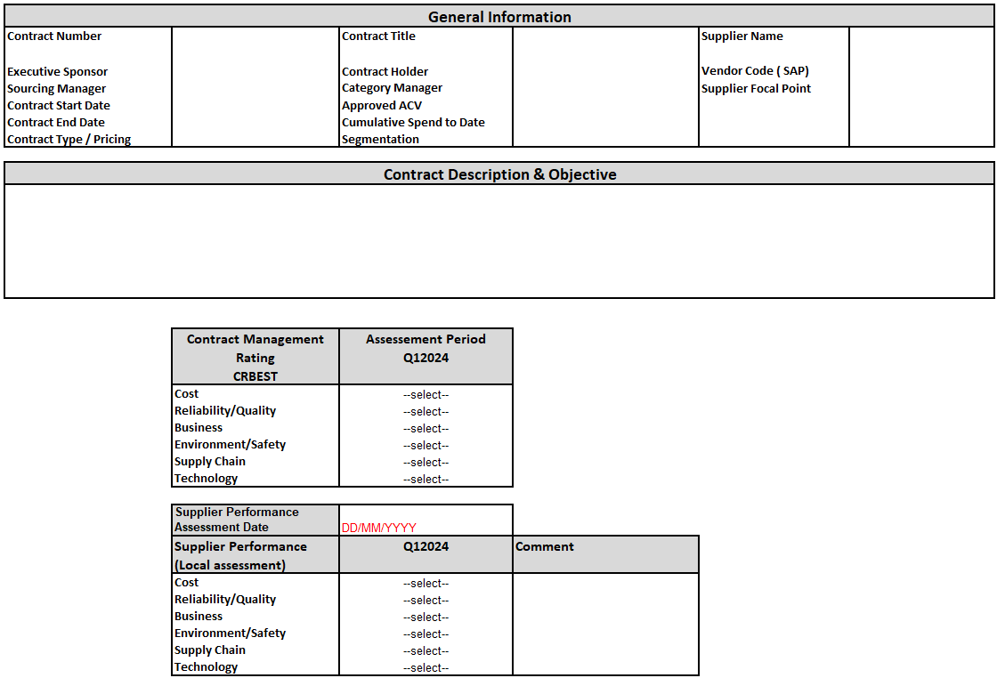
CONTRACT MANAGEMENT PLAN SHOULD BE…
Contract Management Plan overview
Finalized within a month of the external kick-off meeting
Shared with the supplier and internal stakeholders
Routinely used to monitor & review contract performance
Maintained as a working document throughout the life of the contract
Used as a guideline to conduct performance review meetings
Adjusted (incl. the contract, if necessary) based on risks & opportunities
Notes:
Ask team if anyone uses a contract management plan. If someone does ask them to share how they use it and the outcomes. If no one does have a discussion about what should be in one.
Before going to the next slide to talk about the relationship strategy – take a category like drill bits/Maintenance service and go through a Kraljic exercise (with or without the excel spreadsheet). Ask questions like how would they classify spend, risk, number of suppliers, lead time, standard vs. custom. What would the impact be if parts were not available? Then ask them to think about pencils. What are the contrasts?

Slide 26
4b. AGREE ON RELATIONSHIP MANAGEMENT PROCESS
1
2
3
“We should treat our key suppliers as well as we treat our key customers”… - Dave Packard
Steps:
Analyze nature of the current relationship
Determine desired relationship level
Develop relationship strategy
  Communication lines
  Rules of engagement
  Relationship guidelines (policies and procedures)
    Frequency of meetings
    Types of meetings (events, site visits etc.)
    Level of “supplier service” (e.g. pick-up from airports/hotels etc.)
*

Slide 27
DETERMINING RELATIONSHIP LEVEL
 | TRANSACTIONAL | PREFERRED | STRATEGIC | PARTNER
Relationship between Executive Leadership | None | None | Some Occasional top level meetings | Strong Regular top level meetings Top management participation in developing strategies
Relationship between Operational Personnel | Procurement & sales | Proc & sales Sales & customer internal user OR Proc. & supplier internal operations | Cross operational relationships (proc & sales & internal stakeholders on both sides) | Multi level relationships
Focus | Price | Price | Cost, assurance of supply | Value, TCO, long-term competitive advantage
Transparency (information sharing) | None | Limited | Share high level operations, technology and some cost data. Some collaboration on R&D and cost management Limited feedback program | Full Transparency of cost, process and technology data Robust 360-degree feedback process Tech. convergence Collaborative strategies Joint ventures / investments
Contract term | Short term | Short-Medium term | Medium-Long term | Long term
Notes:
Partner – Harley Davidson CEO allocates 60 days per year for supplier visits. Freeport McMoRan regularly visits suppliers and spends a lot of time inviting the suppliers to events.

Slide 28
ESTABLISHING LINES OF COMMUNICATION
Buyer
TRANSACTIONAL
Supplier
Buyer
PREFERRED
Supplier
Executive leadership
None
Executive leadership
Executive leadership
None
Executive leadership
Internal stakeholders
None
Internal stakeholders
Internal stakeholders
Internal stakeholders
Procurement
Sales
Procurement
Sales
Buyer
STRATEGIC
Supplier
Buyer
PARTNER
Supplier
Executive leadership
Executive leadership
Executive leadership
Executive leadership
Internal stakeholders
Internal stakeholders
Internal stakeholders
Internal stakeholders
Procurement
Sales
Procurement
Sales

Slide 29
BUILDING LOYALTY
Supplier Loyalty Ladder
Invests in customer
Puts best resources on collaborative new product development
Preferential treatment (allocation/pricing)
Value added services
Preferential pricing
Transactional
CUSTOMER
* Adapted from: Building Loyalty in Business Markets, Dr. Das Narayandas, Harvard Business Review, Sept 2005
Notes:
Focus on the Blue Ladder and talk about the Harley Davidson Story. This is a company with such brand equity that people tattoo the company logo on their body. Harley sets objectives and involves suppliers from the get go so that they do make mistakes. FYI – Honda and Toyota hate cost savings and prefer cost avoidance – cost savings mean that they were not doing things in an optimal manner.

Slide 30
CRITICAL SUCCESS FACTORS FOR RELATIONSHIP MANAGEMENT:
Robust problem resolution process (ombudsman)
Select the appropriate relationship level
Leverage each other’s strengths
Top management commitment and consistency of message
Risk and reward sharing
Walk the talk
Trust and openness

Slide 31
SUMMARY & CHECKLIST: INITIATE CONTRACT MANAGEMENT
Review Objectives:
Align stakeholders, suppliers and the contract management team around the objectives of the contract
Review of objective:
Review Activities:
Identify Stakeholders, Define Roles and Responsibilities
Conduct Internal and External Kick-off Meetings
Develop Performance Measurement System
Agree on Contract and Relationship Management Process and Plan

Slide 32
MANAGE CONTRACT
Introduction to Contract Management
Initiate Contract Management
1. Identify Stakeholders & Define Roles and Responsibilities
2. Conduct Internal and External Kick-off Meetings
3. Develop Performance Measurement System
(Measuring Performance, KPIs, Supplier Performance Score Card)
4. Agree on Contract Management Plan (CMP)
5. Agree on Relationship Management Process
Summary and Checklist
Manage Contract
Measure Supplier’s Performance
(KPIs, Spend, Financial Health)
Conduct Performance Reviews
Manage Contract Pricing
Conduct Value Improvement Program
Manage and Control Changes, Claims and Disputes
Summary and Checklist
Close Contract
Conclude Supply Agreement
Capture Lessons Learned
Summary and Checklist

Slide 33
MANAGE CONTRACT
Objectives:
To fulfill contractual objectives
To manage supplier relationship and contract performance to maximize value during the lifecycle of the contract
Steps:
1
2
3
Measure Supplier’s Financial Health & Performance (KPIs)
Conduct Performance Reviews
Manage Contract Pricing (CAMSTM/Price DisciplineTM)
Conduct Value Improvement Programs (A&D Cost Challenge)
Manage & Control Contract Changes, Claims & Disputes
1
2
3
1
2
3
1
2
3
1
2
3
  Key outcomes:
  Performance Reviews
  Supplier Relationship
  Continuous Improvement

Slide 34
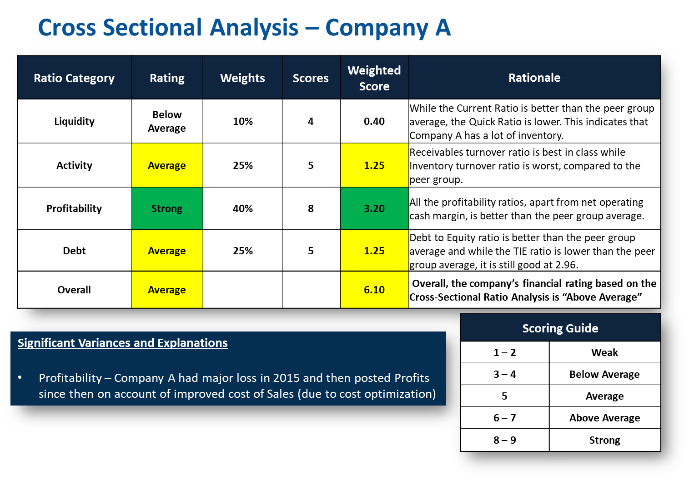
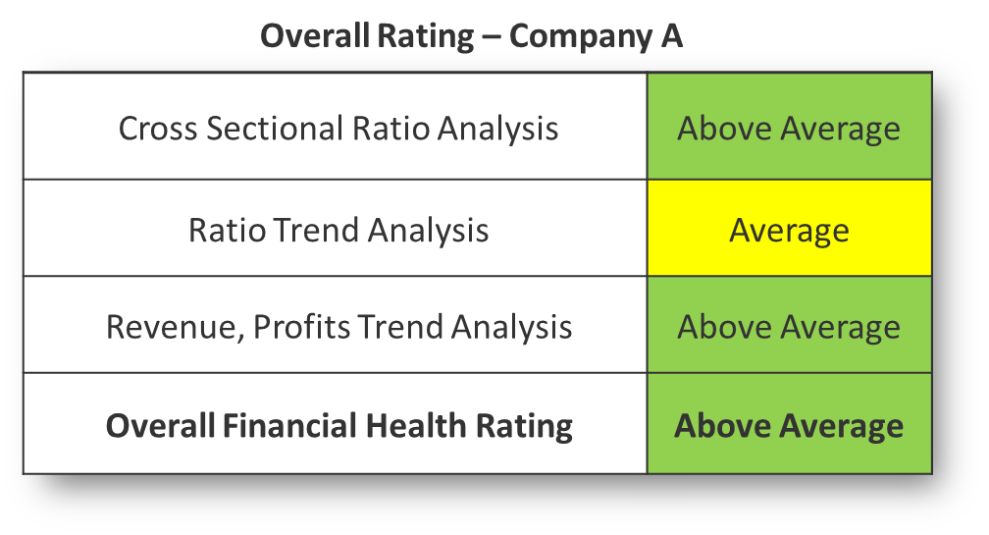
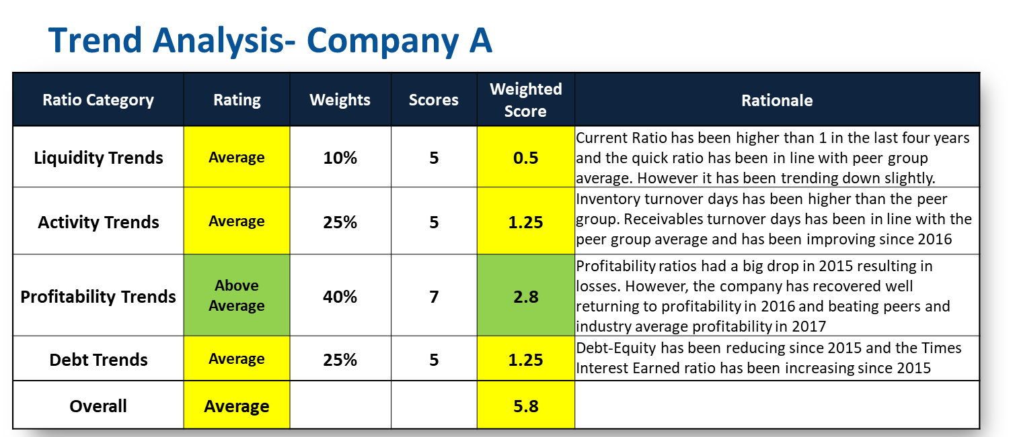
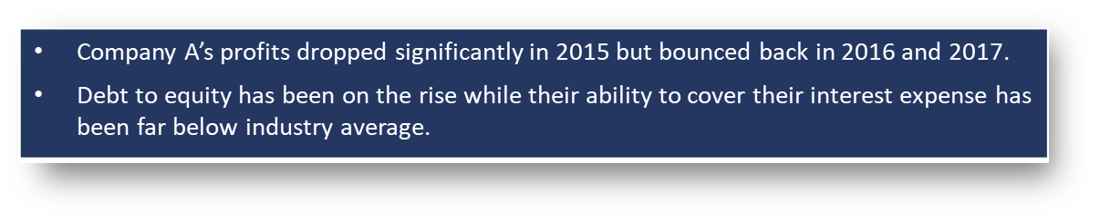
1a. MEASURE SUPPLIER’S FINANCIAL HEALTH
1
2
3
Evaluate financial health of the supplier regularly (semi-annually/ annually)
  Cross sectional analysis evaluates financial health against industry or peers
  Trend analysis evaluates company’s performance over time

Slide 35
1b. MEASURE SUPPLIER’S PERFORMANCE (KPIs)
1
2
3
Score the supplier’s performance using the agreed Scorecard - Example:
Attribute | Max Score | Score | Measure
Cost | 300 | 200 | Meet or exceed Min Advantage Target Unit cost
Reliability/Quality | 300 | 290 | Process yield (% of defective parts) Incoming yield (defective ppm) Results of quality audits
Business | 100 | 100 | Financial health (e.g. ratios of company vs. industry)
Environment/Safety | 100 | 75 | Number of safety incidents Results of environmental/safety inspection
Supply Chain | 100 | 90 | % on time and in-full deliveries % electronic orders (with Tier 2 suppliers) Inventory turns
Technology | 100 | 30 | Investment in R&D Capital investment plan

Slide 36
2. CONDUCT PERFORMANCE REVIEWS
1
2
3
Points to consider
  Conduct Performance Reviews regularly (Tier 1: quarterly / Tier 2: annually) involving company and supplier
  Make them specific and meaningful
  Use contract management plan as an input to a standardized meeting agenda to discuss the following:
    Current performance vs. agreed KPIs - Supplier should present status of KPI’s and other value improvement initiatives
    What is going well and not so well
    Identify and drive business improvement opportunities
    Any updated Company demand plan/outlook
    How to create closer alignment in operations/technology/commercial
    How to enhance the relationship

Slide 37
Contract compliance reviews
Points to consider
  Contract compliance reviews should be conducted from time to time to:
    provide an in-depth investigation into implementation and execution of the contract
    determine whether the contract objectives are being fulfilled
    ensure and acknowledge continuous performance improvement and share contract management-related improvement opportunities
  Verify that the company is delivering on its commitments to the supplier
Notes:
Points to consider
Contract Compliance Reviews should be conducted from time to time to provide an in-depth investigation into the practical implementation and execution of a contract. Its purpose is to determine whether the contract objectives are being realized and to ensure and acknowledge continuous performance improvement and share contract management-related improvement opportunities.
Verify that the company is delivering on its commitments to the supplier. In order to have effective Business Process Reviews and Contract Compliance Reviews it is essential that the supplier and company have a trust based relationship whereby the supplier is encouraged and deems it appropriate to openly advise company of non-compliance in any aspect of the contract.

Slide 38
3. MANAGE CONTRACT PRICING (CAMS™)
1
2
3
Measure competitiveness by comparing company and market cost trends
A competitive advantage exists when:
  The company’s costs rise slower than the market; OR
  The company's costs fall faster than the market
Competitive Advantage Measurement System (CAMS™)

Slide 39
MANAGE CONTRACT PRICING (PRICE DISCIPLINETM)
Points to consider
  Breakdown contract pricing into its cost elements
  Track changes of the cost elements through indices
  Agree on price adjustments based on changes in the cost elements
    This will set a fair and reasonable structure for all future contract pricing discussions and adjustments
  Price Discipline can be used internally on fixed price projects to prepare for end of term price review
  Price Discipline can be used to develop and measure value improvement ideas (AIM&DRIVE Cost Challenge)
    Identify and track key cost drivers
Notes:
If not already done prior to and during negotiation, the agreed contract pricing should be decomposed into its cost elements and this cost breakdown should be mutually agreed between the company and the supplier, soon after the contract is effective. This will set a fair and reasonable structure for all future contract pricing discussions and adjustments.
The Price Discipline model should also be used to develop and measure value improvement ideas (AIM&DRIVE Cost Challenge), via the identification and tracking of the key cost drivers.

Slide 40
PRICE DISCIPLINETM MODEL EXAMPLE
Notes:
The Price Discipline model should also be used to develop and measure value improvement ideas (AIM&DRIVE Cost Challenge), via the identification and tracking of the key cost drivers.

Slide 41
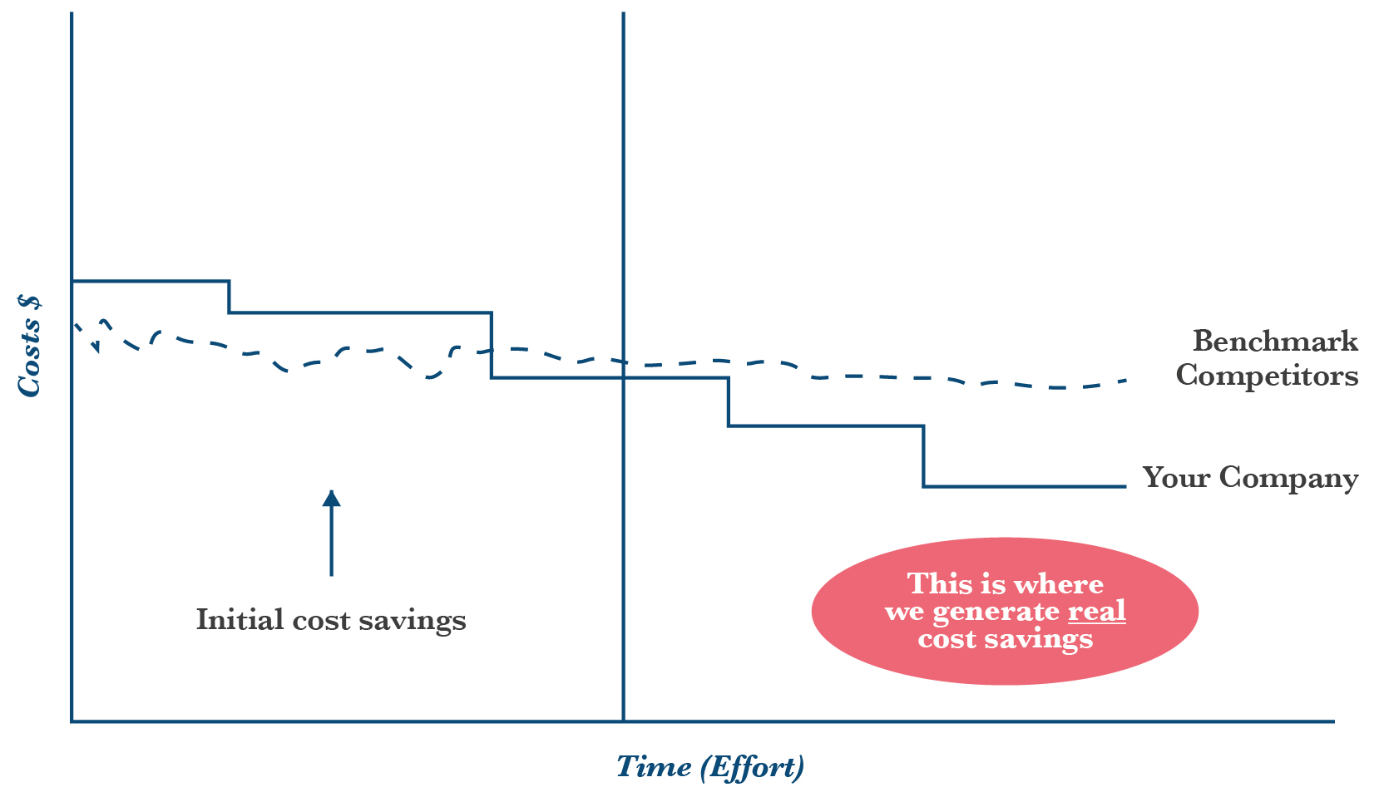
MANAGE CONTRACT PRICING & CONDUCT VALUE IMPROVEMENT
Cost Competitiveness
Leverage purchase volume
Automate processes
Analyze supplier prices
Understand cost
  Total Cost of Ownership
  Price breakdown
Cost Breakthrough
Jointly develop written cost management
strategies with supplier (Cost Challenge)
Execute strategies with maximum speed
Create knowledge base to leverage ideas

Slide 42
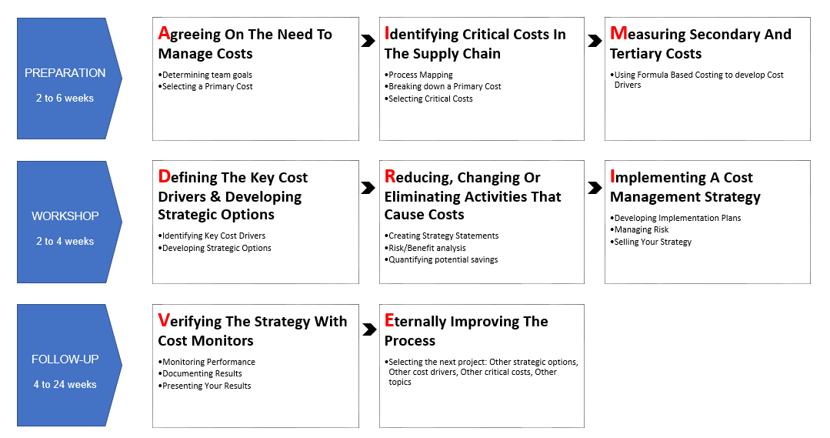
4. CONDUCT VALUE IMPROVEMENT PROGRAM
(AIM&DRIVE® COST CHALLENGE)
1
2
3

Slide 43
VALUE IMPROVEMENT PROGRAM
(AIM&DRIVE® COST CHALLENGE)
Points to consider
  Typical savings are derived from the following sources: 40% specifications, 40% demand and 20% price*
    Value improvements are achieved when each of these elements are challenged
  Start the Value Improvement Program internally (if possible) to understand and manage the internal key cost and value drivers before inviting a supplier to participate in the program
  Use the TCO model and Price DisciplineTM model as tools to develop and measure value improvement ideas
* McKinsey Research
Notes:
It is often well worth starting the Value Improvement Program internally (refer to step ‘Develop Strategy’), and understand and manage the internal key cost and value drivers before inviting a supplier to participate in the program
Use the AIM&DRIVE process, along with the TCO and Price Discipline models, as tools to develop and measure value improvement ideas
Specification
Challenge local Standards
Standardize
Find Substitutes
Change Product Specifications
Design to Cost
Demand
Improvement Opportunities
Review Needs
Reduce Inventory
Demand Management
Price
Control & Analysis
Change Supplier Structure
Renegotiate Contracts
Bundle

Slide 44
VALUE IMPROVEMENT PROGRAM: MAKE IT A REGULAR EVENT
Points to consider
  Identify contracts with strong relationships, high value and strategic importance
  Schedule mid-contract initially and annually after first round.
  Ensure participation by appropriate stakeholders.
  Primary focus around demand and specifications
  Timeline 4-6 weeks which includes pre-workshop prep work, workshop, analysis, closeout and implementation plan follow-up.

Slide 45
5a. MANAGE & CONTROL CONTRACT CHANGES
1
2
3
Points to consider
  Additions, reductions or changes to the original scope of the contract or the terms & conditions comprise contract changes
  Variations or amendments to contract are usually required for:
    Changes in work scope or the method of execution of the scope
    Changes in facilities or resources required
    Rate revisions, contract extensions and changes to terms & conditions
    Claim settlements
  Follow company’s change management workflow for administering contract changes

Slide 46
5b. MINIMIZE CLAIMS & DISPUTES
1
2
3
Points to consider
  Define work scope, specs, deliverables and timelines comprehensively
  Identify all relevant risks and develop a mitigation plan for each risk
  Establish clear and frequent communication with the supplier
  Maintain records of meetings and communications
  Use the formal change management process & maintain the change management plan
  Manage the contract and the relationship, not the contractor
  Institute strong contract and relationship management, have strong project leadership

Slide 47
SUMMARY & CHECKLIST: MANAGE CONTRACT
Review Objectives:
Deliver contractual objectives
Manage supplier relationship and contract performance to maximize value during the lifecycle of the contract
Review of objective:
Review Activities:
Measure Supplier's Performance (KPIs) and Financial Health
Conduct Performance Reviews
Manage Contract Pricing (Price DisciplineTM)
Conduct Value Improvement Program (AIM&DRIVE® Cost Challenge)
Manage & Control Contract Changes, Claims & Disputes

Slide 48
CLOSE CONTRACT
Introduction to Contract Management
Initiate Contract Management
1. Identify Stakeholders & Define Roles and Responsibilities
2. Conduct Internal and External Kick-off Meetings
3. Develop Performance Measurement System
(Measuring Performance, KPIs, Supplier Performance Score Card)
4. Agree on Contract Management Plan (CMP)
5. Agree on Relationship Management Process
Summary and Checklist
Manage Contract
Measure Supplier’s Performance
(KPIs, Spend, Financial Health)
Conduct Performance Reviews
Manage Contract Pricing
Conduct Value Improvement Program
Manage and Control Changes, Claims and Disputes
Summary and Checklist
Close Contract
Conclude Supply Agreement
Capture Lessons Learned
Summary and Checklist

Slide 49
CLOSE CONTRACT
Objectives:
To secure completion and delivery of goods/services and final closure of all legal and contractual obligations with a supplier
To capture lessons learned to improve future performance
Steps:
1
2
3
Conclude supply agreement
Capture lessons learned
1
2
3
  Key outcomes:
  Close-out activities
  Feedback

Slide 50
1. CONCLUDE SUPPLY AGREEMENT
1
2
3
Points to consider
  Decide the path forward (contract extension/new sourcing event) prior to expiration of the current contract
  Consider cost of change, if the decision is to develop a new sourcing strategy
  Review terms and conditions of the current contract to fully understand the implications of the contract expiration/termination
  Note: Lessons learned and decision on path forward may have to be made well in advance of the contract expiration, e.g. 1 year before. Ensure alignment with or creation of a sourcing strategy.
Notes:
In advance of the expiry of a contract, one should decide whether the contract should be allowed to expire or whether a new sourcing strategy is required. If the decision is taken to develop a new sourcing strategy, the likely cost of change should be factored into the strategy. The contract terms and conditions plus all relevant records should be reviewed to ensure that the company fully understands the implications of the contract expiry/termination.
Typical requirements of a contract close out process are:
complete and verify delivery of goods & services;
confirm technical and financial completion;
complete and verify handover of work, spare parts or surplus materials;
dispose of surplus material;
release of warranties;
cut-off date for honoring third party invoices;
final invoice from supplier;
settlement of claims

Slide 51
CONCLUDE SUPPLY AGREEMENT
Points to consider
  Typical requirements of a contract close out process are:
    Complete and verify delivery of goods & services
    Confirm technical and financial completion
    Complete and verify handover of work, spare parts or surplus materials
    Dispose of surplus material
    Release of warranties
    Cut-off date for honoring third party invoices
    Final invoice from supplier
    Settlement of claims

Slide 52
CHECKLIST OF KEY ELEMENTS TO BE MANAGED AT CLOSE OUT
Technical | Operational
HSSE | Commercial
Conduct inspections of Goods & Services received
Check documentation received
Prepare checklist (incl. defects & outstanding item)
Ascertain suppliers readiness for demobilisation
Document the final inspection & accept the goods & services
Disposal of surplus materials
Data downloads ( e.g.: maintenance records)
Vendor drawings
Operating manuals
Licenses
Spares
Test equipment
Certification
Warranty documents, etc.
Ensure HSSE reports and statistics finalised and received
Surplus stock & company owned material returned
Transfer of insurances
Close customs reporting
Release of securities, etc.

Slide 53
2. CAPTURE LESSONS LEARNED
1
2
3
Points to consider
  Evaluate supplier’s and company’s performance, share feedback and capture lessons learned
    Operational
    Relationship
    Financial
  Conduct a close out meeting or workshop with all relevant stakeholders and supplier
    Distill regular Performance Reviews to identify key improvement areas
    Get supplier’s feedback to improve company’s relationship management
    Hold an appreciation event
Notes:
The objective of this activity is to appraise supplier & company performance, provide feedback and capture learning, which can be a reference to future work.
Ideally, throughout the contract, supplier performance should be monitored against the Contract Management Plan and if applicable, Business Performance Reviews.
The final contract close out is the distillation of the regular monitoring process and the end of contract review. This may take the form of a close out meeting where all relevant stakeholders are present or simply in report format.

Slide 54
SUMMARY & CHECKLIST: CLOSE CONTRACT
Review Objectives:
Secure completion and delivery of goods/services and final closure of all legal and contractual relationships with a supplier
Capture lessons learned to improve future performance
Review of objective:
Review Activities:
Conclude supply agreement
Capture lessons learned

Slide 55
CONTRACT MANAGEMENT TAKEAWAYS
Ensure roles and responsibilities are assigned and stakeholders involved throughout the contract delivery
Align with the supplier on delivery and other topics such as HSSE and value improvement
Drive and monitor supplier and company performance
Routinely manage contract pricing by tracking cost elements
Engage in continuous value creation/ improvement and risk reduction
Provide feedback to suppliers and stakeholders through performance reviews
Evaluate contract renewal/ expiration and contract/ category strategy
Ensure contractual obligations are ended with contract expiration

